Slide 1
SWE2005-SOFTWARE TESTING
Module 1
Dr . Shivani Gupta,
VIT Chennai

Slide 2
Topics to be covered
Introduction
Evolution of Software testing
Goals of Software Testing
Testing Fundamentals
Psychology
Software Testing Models
Software testing Life cycle
Testing methodology

Slide 3
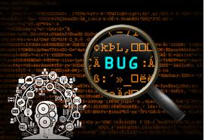
Why Testing is done?
Finding bugs ,defects.

Slide 4
Aim of Testing….
To confirm the quality of software systems by systematically exercising the software

Slide 5
Introduction
Testing in customer perspective….
Able to find possible defects.
Must give confidence that users are protected from failures of the product.
Ensure legal requirements

Slide 6
Introduction
Testing in tester perspective….
To discover defects to improve the product and processes.
To find fault or weakness in a work product.

Slide 7
Introduction
Testing during development cycle….
Requirements testing
Design Testing
Coded Testing
Test scenario and Test case testing

Slide 8
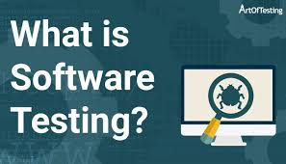

Slide 9
Software testing is a process of verifying and validating that a software application or program .
1. Meets the business and technical requirements that guided its design and development, and
2. Works as expected.

Slide 10
EVOLUTION OF SOFTWARE TESTING
Debugging-oriented Phase (Before 1957)
Demonstration-oriented Phase (1957–78)
Destruction-oriented Phase (1979–82)
Prevention-Oriented Phase (1983–87)
Evaluation-oriented Phase (1983–87)
Process-oriented Phase (1996 onwards)

Slide 11
Goals
Immediate Goals
Bug discovery
Bug prevention
Long Term Goals
Reliability
Quality
Customer Satisfaction
Risk Management
Post Implementation Goals
Reduced Maintenance Cost
Improved testing process

Slide 12
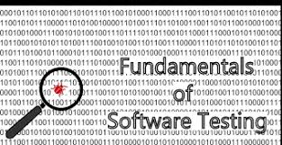

Slide 13
Testing Fundamentals
1. Error:
An Error is a mistake, misconception, or misunderstanding on the part of software developers.
2. Faults:
A fault(Defect or bug) is introduced into the software as the result of an error.
3. Failures:
A failure is the inability of a software or component to perform its required functions within specified performance requirements.

Slide 14
Testing Fundamentals
Test Cases:
A set of test inputs + Execution Condition+ Expected Outputs
Test :
A group of related test cases, or a group of related test cases and test procedures (steps needed to carry out a test)

Slide 15
Testing Fundamentals
Test Oracle:
Is a document, or piece of software that allows testers to determine whether a test has been passed or failed.
Test Bed:
An environment that contains all the hardware and software needed to test a software components or a software system.

Slide 16
Testing Fundamentals
Reviews:-
Group meeting whose purpose is to evaluate a software artifact or a set of software artifacts.
Debugging :
Process begins after testing has been carried out
Verification: Are we doing product right?
Validation : Are we doing right product?

Slide 17
Good Testing means…
Capturing user requirements
Capturing user needs
Design Objectives
User Interfaces
Internal Structures
Execution of code

Slide 18


Slide 19
What is Testing Principle…
A principle can be defined as
1. A general or fundamental , law, doctrine, or assumptions;
2. A rule of code of conduct;
3. The laws or facts of nature underlying the working of an artificial device.
There are 11 testing principles
(Ilene Burnstein)

Slide 20
Testing Principles…
Principle 1: Testing is the process of exercising a software components using a
selected set of test cases, with the intent of
(i) Revealing Defects
(ii) Evaluating Quality

Slide 21
Testing Principles…
Principle 2: When the test objectives is to detect defects, then a good test case is one that has a high probability of revealing a yet-undetected defect(s).
Principle 3:- Test results should be inspected meticulously

Slide 22
Testing Principles…
Principle 4:- A test case must contain the expected output or result.
Principle 5:- Test case should be developed for both valid and invalid input conditions.
Principle 6:- The probability of the existence of additional defects in a software component is proportional to the number of defects already detected in that component.

Slide 23
Testing Principles…
Principle 7:- Testing should be carried out by a group that is independent of the development group.
Principle 8:- Tests must be repeatable and reusable
Principle 9:- Testing should be planned

Slide 24
Testing Principles…
Principle 10:- Testing activities should be integrated into the software.
Principle 11:- Testing is a creative and challenging task.

Slide 25
Psychology of software testing
Independent testing
Makes the tester more effective in finding defects and failures.
Levels of independence
Tests designed by person who wrote the software under test
Tests designed by another person
Tests designed by a person from a different organization or company

Slide 26
SOFTWARE TESTING—MYTHS AND FACTS
Myth Testing is a single phase in SDLC .
Truth It is a myth, at least in the academia, that software testing is just a phase in SDLC and we perform testing only when the running code of the module is ready.
Myth Testing is easy.
Truth This myth is more in the minds of students who have just passed out or are going to pass out of college and want to start a career in testing. So the general perception is that, software testing is an easy job, wherein test cases are executed with testing tools only.

Slide 27
Myth Software development is worth more than testing.
Truth This myth prevails in the minds of every team member and even in freshers who are seeking jobs. As a fresher, we dream of a job as a developer. We get into the organization as a developer and feel superior to other team members.
Myth Complete testing is possible.
Truth This myth also exists at various levels of the development team. Almost every person who has not experienced the process of designing and executing the test cases manually feels that complete testing is possible. Complete testing at the surface level assumes that if we are giving all the inputs to the software, then it must be tested for all of them.

Slide 28
Myth Testing starts after program development.
Truth Most of the team members, who are not aware of testing as a process, still feel that testing cannot commence before coding. But this is not true. As mentioned earlier, the work of a tester begins as soon as we get the specifications.
Myth The purpose of testing is to check the functionality of the software.
Truth Today, all the testing activities are driven by quality goals. Ultimately, the goal of testing is also to ensure quality of the software. But quality does not imply checking only the functionalities of all the modules

Slide 29
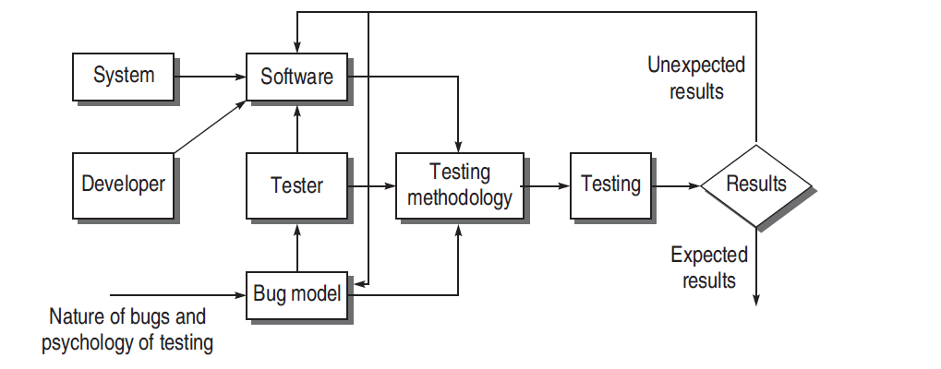
MODEL FOR SOFTWARE TESTING

Slide 30
Components of Software Testing Model
Software and Software Model
Bug Model
Testing methodology and Testing

Slide 31
SCHOOLS OF SOFTWARE TESTING
Software testing has also been classified into some views according to some practitioners. They call these views or ideas as schools of testing.
The idea of schools of testing was given by Bret Pettichord.

Slide 32
1
Analytical School of Testing
2
Standard School of Testing
3
Quality School of Testing
Context-driven School of Testing
4
5
Agile School of Testing

Slide 33
Software Testing Life Cycle (STLC)

Slide 34
Requirements Capture
Analysis
Test Planning & Scenario Design
Test Case Development
Modification /New
Defect Fixing
Test Execution
New Version
Test cycle Closure
Defects
Test Result Analysis

Slide 35
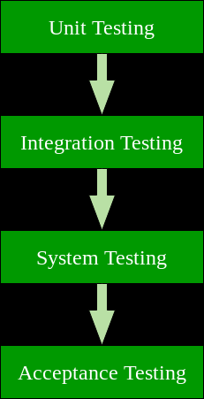
Testing Spectrum

Slide 36
Types of Testing Techniques
Black Box Testing
White Box Testing
Note: Testing can be done manually or Automatically

Slide 37
Black box testing
Also known as Functional Testing
No knowledge of interior workings of the product.
Does not consider any internal processing of the system
Tester does not have any access to source code.
Tester will interact with user interface with inputs , outputs and general functionalities documented in requirements phase

Slide 38
Black box testing
Requirements
Input
Output
Events

Slide 39
Types
Equivalence Partitioning
Boundary Value Analysis
Cause and Effect graph
State Transition Testing
Use case Based testing
Error Guessing

Slide 40
Advantages | Disadvantages
Well suited and efficient for large code segments. | Limited coverage, since only a selected number of test scenarios is actually performed.
Code access is not required. | Inefficient testing, due to the fact that the tester only has limited knowledge about an application. Test cases are difficult to design
Black-Box Testing

Slide 41
White box testing
Done based on internal structures i.e internal logic and structure of the code.
Also known as glass testing or open box testing or structural testing.

Slide 42
White box testing
Design Specifications
Input
Output
Events, standards, guidelines

Slide 43
Types
Statement Coverage
Decision Coverage
Condition coverage
Path Coverage
Logic Coverage

Slide 44
Advantages
Disadvantages
Primary method of verification
Ensures defined processes, procedures and methods
Early warnings
Effective way of finding defects
Reduces stage contamination.
Tester has knowledge of the source code, maximum coverage is attained
Does not ensure user requirements are met.
No execution of code.
Dominated by usage of checklists

Slide 45
Disadvantages
Does not ensure user requirements are met.
No execution of code.
Dominated by usage of checklists

Slide 46
Software Process Models
Waterfall Model.
V-Shaped Model.
Prototype Model.
Iterative Incremental Model
Spiral Model
Agile Model

Slide 47
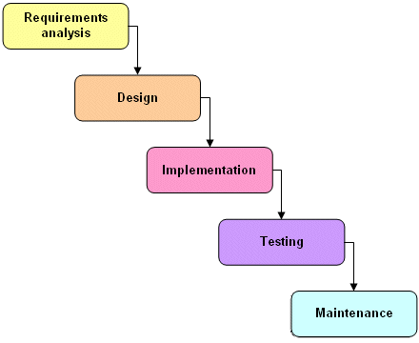
Waterfall Model

Slide 48
Waterfall model
Waterfall model is the very first model that is used in SDLC. It is also known as the linear sequential model.
In this model, the outcome of one phase is the input for the next phase. Development of the next phase starts only when the previous phase is complete.
First, Requirement gathering and analysis is done. Once the requirement is freeze then only the System Design can start. Herein, the SRS document created is the output for the Requirement phase and it acts as an input for the System Design.
In System Design Software architecture and Design, documents which act as an input for the next phase are created i.e. Implementation and coding.

Slide 49
In the Implementation phase, coding is done and the software developed is the input for the next phase i.e. testing.
In the testing phase, the developed code is tested thoroughly to detect the defects in the software. Defects are logged into the defect tracking tool and are retested once fixed. Bug logging, Retest, Regression testing goes on until the time the software is in go-live state.
In the Deployment phase, the developed code is moved into production after the sign off is given by the customer.
Any issues in the production environment are resolved by the developers which come under maintenance.

Slide 50
Advantages of the Waterfall Model:
Waterfall model is the simple model which can be easily understood and is the one in which all the phases are done step by step.
Deliverables of each phase are well defined, and this leads to no complexity and makes the project easily manageable.

Slide 51
Disadvantages of Waterfall model:
Waterfall model is time-consuming & cannot be used in the short duration projects as in this model a new phase cannot be started until the ongoing phase is completed.
Waterfall model cannot be used for the projects which have uncertain requirement or wherein the requirement keeps on changing as this model expects the requirement to be clear in the requirement gathering and analysis phase itself and any change in the later stages would lead to cost higher as the changes would be required in all the phases.

Slide 52
V-Model
V- Model is also known as Verification and Validation Model.
In this model Verification & Validation goes hand in hand i.e. development and testing goes parallel.
V model and waterfall model are the same except that the test planning and testing start at an early stage in V-Model.

Slide 53
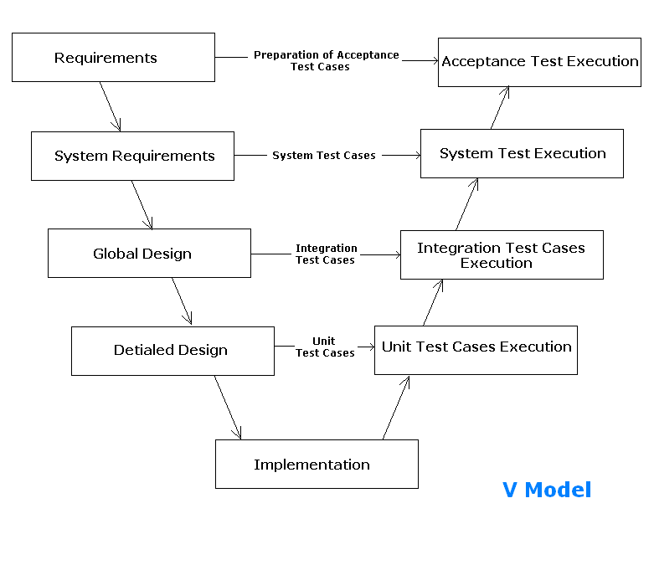
V-model (contd..)

Slide 54
Verification Phase
(i) Requirement Analysis:
In this phase, all the required information is gathered & analyzed. Verification activities include reviewing the requirements.
(ii) System Design:
Once the requirement is clear, a system is designed i.e. architecture, components of the product are created and documented in a design document.
(iii) High-Level Design:
High-level design defines the architecture/design of modules. It defines the functionality between the two modules.
(iv) Low-Level Design:
Low-level Design defines the architecture/design of individual components.
(v) Coding:
Code development is done in this phase.

Slide 55
Validation Phase
(i) Unit Testing:
Unit testing is performed using the unit test cases that are designed and is done in the Low-level design phase. Unit testing is performed by the developer itself. It is performed on individual components which lead to early defect detection.
(ii) Integration Testing:
Integration testing is performed using integration test cases in High-level Design phase. Integration testing is the testing that is done on integrated modules. It is performed by testers.
(iii) System Testing:
System testing is performed in the System Design phase. In this phase, the complete system is tested i.e. the entire system functionality is tested.
(iv) Acceptance Testing:
Acceptance testing is associated with the Requirement Analysis phase and is done in the customer’s environment.

Slide 56
Advantages Disadvantages
It is a simple and easily understandable model.
V –model approach is good for smaller projects wherein the requirement is defined and it freezes in the early stage.
It is a systematic and disciplined model which results in a high-quality product.
V-shaped model is not good for ongoing projects.
Requirement change at the later stage would cost too high.

Slide 57
Prototype Model
The prototype model is a model in which the prototype is developed prior to the actual software.
Prototype models have limited functional capabilities and inefficient performance when compared to the actual software. This is a valuable mechanism for understanding the customers’ needs.
Software prototypes are built prior to the actual software to get valuable feedback from the customer. Feedbacks are implemented and the prototype is again reviewed by the customer for any change. This process goes on until the model is accepted by the customer.

Slide 58
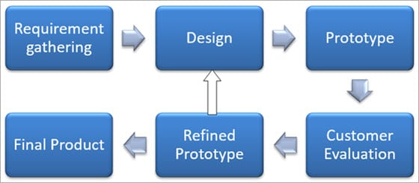

Slide 59
Advantages Disadvantages
Prototype model reduces the cost and time of development as the defects are found much earlier.
Missing feature or functionality or a change in requirement can be identified in the evaluation phase and can be implemented in the refined prototype.
Involvement of a customer from the initial stage reduces any confusion in the requirement or understanding of any functionality.
Since the customer is involved in every phase, the customer can change the requirement of the end product which increases the complexity of the scope and may increase the delivery time of the product.

Slide 60
Iterative Incremental Model
The iterative incremental model divides the product into small chunks.
In an Iterative Incremental model, initially, a partial implementation of a total system is constructed so that it will be in a deliverable state. Increased functionality is added.
Defects, if any, from the prior delivery are fixed and the working product is delivered.
The process is repeated until the entire product development is completed.
The repetitions of these processes are called iterations. At the end of every iteration, a product increment is delivered.

Slide 61
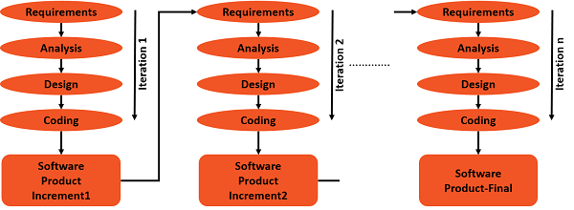

Slide 62
Advantages Disadvantages
You can develop prioritized requirements first.
Initial product delivery is faster.
Customers gets important functionality early.
Lowers initial delivery cost.
Each release is a product increment, so that the customer will have a working product at hand all the time.
Customer can provide feedback to each product increment, thus avoiding surprises at the end of development.
Requirements changes can be easily accommodated.
Requires effective planning of iterations.
Requires efficient design to ensure inclusion of the required functionality and provision for changes later.
Requires early definition of a complete and fully functional system to allow the definition of increments.
Well-defined module interfaces are required, as some are developed long before others are developed.
Total cost of the complete system is not lower.

Slide 63
Spiral Model
Spiral model phases are followed in the iterations. The loops in the model represent the phase of the SDLC process i.e. the innermost loop is of requirement gathering & analysis which follows the Planning, Risk analysis, development, and evaluation. Next loop is Designing followed by Implementation & then testing.
Spiral Model has four phases:
Planning
Risk Analysis
Engineering
Evaluation

Slide 64
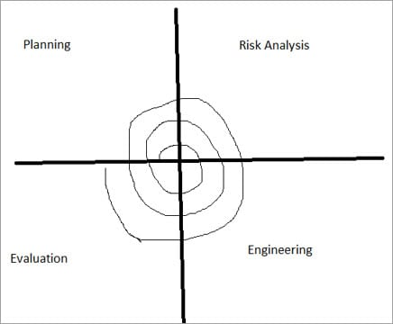

Slide 65
Advantages of Spiral Model:
Risk Analysis is done extensively using the prototype models.
Any enhancement or change in the functionality can be done in the next iteration.
Disadvantages of Spiral Model:
The spiral model is best suited for large projects only.
The cost can be high as it might take a large number of iterations which can lead to high time to reach the final product.

Slide 66
Agile SDLC model
This model is a combination of iterative and incremental process models with focus on process adaptability and customer satisfaction by rapid delivery of working software product. Agile Methods break the product into small incremental builds. These builds are provided in iterations. Each iteration typically lasts from about one to three weeks. Every iteration involves cross functional teams working simultaneously on various areas like −
Planning
Requirements Analysis
Design
Coding
Unit Testing and
Acceptance Testing.
At the end of the iteration, a working product is displayed to the customer and important stakeholders.

Slide 67
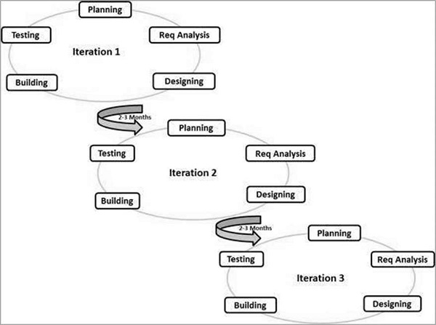

Slide 68
The advantages of the Agile Model are as follows −
Is a very realistic approach to software development.
Promotes teamwork and cross training.
Functionality can be developed rapidly and demonstrated.
Resource requirements are minimum.
Suitable for fixed or changing requirements
Delivers early partial working solutions.
Minimal rules, documentation easily employed.
Easy to manage.
Gives flexibility to developers.
The disadvantages of the Agile Model are as follows −
Not suitable for handling complex dependencies.
More risk of sustainability, maintainability and extensibility.
Depends heavily on customer interaction, so if customer is not clear, team can be driven in the wrong direction.
Transfer of technology to new team members may be quite challenging due to lack of documentation.

Slide 69
Summary
Introduction of ST
Definition
Principles
Types of ST
Black box
White box
Merits & Demerits
Merits & Demerits
Process Models
Waterfall
V Model
Fundamentals
Need
Testing Spectrum
Model
STDLC
Types
Types
Goals
Myths and Facts
Prototype
Agile
Spiral

